Slide 1
Divine Foreknowledge:
Boethius or Open Theism?
Open theism is a new theology introduced in 1994 by a group of highly respected Evangelical scholars.
Led by Clark Pinnock, in a book entitled, The Openness of God.

Slide 2
Their Thesis was:
If humans are really free and not acting out the predetermined decrees of God, then God does not have a full picture of the future.
If God does know the exhaustive future, then everything is going to be just as God knows it and humans do not have the power of contrary choices.

Slide 3
These scholars assured us that “God has a vast amount of knowledge about the probabilities that free choices will be made in one way rather than another.”
Their strong point is their emphasis on the relational character of God.
The problematic feature is the conclusion that God lacks exhaustive omniscience

Slide 4
The two critical questions that I would like to examine are:
(1) Why has the church not embraced this view previously in her 2000 years of thinking about this subject—except for a very few isolated individuals?

Slide 5
(2) Why does Open Theism believe it is incoherent to believe God knows the future if humans posses libertarian freedom?
I will maintain that this historic belief of the church is reasonably consistent and coherent

Slide 6
    (1) Why has the church not embraced Open Theism in the past?
The answer is: because the church believed the Scriptures taught that God has foreknowledge of all things, including the exhaustive future, and that the scriptures also teach that humans are free.

Slide 7
  There were two versions of the traditional view.
    One version is represented by the Early Greek Church Fathers, Boethius, and John Wesley.
    The second version is represented by Augustine and John Calvin.

Slide 8
Justin Martyr (ca. 99-165) wrote apologetics in the second century.
  He argued that God knows the future because the Bible teaches that God predicted the future through the prophets.
  He further argued that the Bible teaches libertarian freedom.

Slide 9
Augustine in the 4th century introduced the concept of absolute predestination into Christian theology.
Although God decrees all things, humans freely decide what God foreordains.

Slide 10
Was he mislead by philosophy?
No, he believed this was the best way to reconcile these two separate teachings of Scriptures

Slide 11
Whether one holds to libertarian freedom of the Early Greek Fathers or to the compatibilist view of Augustine and Calvin, the consensus of Christian thought has been: the Scriptures hold in tension the belief that God knows the future exhaustively and humans possess free will.

Slide 12
John Sanders in the God Who Risks persuasively argues for libertarian freedom.
Von Rad has shown that the prophet Isaiah believes “the Lord of history is he who can allow the future to be told in advance” and “can be exactly calculated.”
Von Rad notes this claim "almost takes one's breath away."

Slide 13
A corollary view of both Boethius and Augustine was their theology of eternity and time.
  Both affirm that Eternity means the undivided instant of all times.

Slide 14
Irenaeus, a disciple of Polycarp who was a disciple of the Apostle John, noted that humans exists in the successive moments of time:
"A man sometimes is at rest and silent, while at other times he speaks and is active." Yet God "always exists one and the same [instant]" and "divisions [of time] cannot fittingly be ascribed to Him."

Slide 15
How is it possible for God to foreknow things?
Irenaeus' answer was that the Scriptures teach this belief.
Irenaeus recognized that this possibility of foreknowledge one of those issues of logic which humans cannot resolve.

Slide 16
Irenaeus noted that there were some things that Jesus did not know.
For example, Jesus frankly said his Father knew the day and hour when Jesus’ would return to the earth, but Jesus himself did not know that detail of that future event.
“If, then, the Son was not ashamed to ascribe the knowledge of that day to the Father only. . . neither let us be ashamed to reserve for God those greater questions which may occur to us.”

Slide 17
One mystery that we cannot explain is what God was doing before he created time.
Irenaeus says time came into being with creation, but then he noted that “no Scripture reveals to us what God was employed about before this event. The answer therefore to that question remains with God, and it is not proper for us to aim at bringing forward foolish, rash, and blasphemous suppositions.”
Our obligation, he says, is to accept the teachings of Scripture

Slide 18
Clement of Alexandria (who died about 215 A.D.) defined eternity this way: “Eternity . . . presents in an instant the future and the present, also the past of time.”

Slide 19
Origen (185-232) appealed, not to philosophy, but to the Scriptures
His reflections on the nature of eternity and its distinction from time was based on his concern to explain the tri-personal relationships of the Trinity.

Slide 20
When the Scriptures teach that "the Father generates” a Son, and “brings forth a Holy Spirit," this does not mean the Father did this in time, but rather this tri-personal relationship was the nature of God before time was created.
If this tri-personal relationship was a product of time, it would disrupt "the Unity of the Trinity" because the Spirit would have to be thought of as being "brought forth" in time and the Son would have been begotten in time.

Slide 21
Because we are temporal and finite, we have to “stretch . . . language” and speak of eternity in our terms “with due allowance.”
Origen concluded that unless God transcends time, God is finite.

Slide 22
Gregory of Nyssa (ca. 331– ca. 396), says that the divine preexistent reality has “no reckoning of time.”
He further writes: “The world’s Creator laid time and space as a background to receive what was to be; on this foundation He builds the universe. It is not possible that anything which has come or is now coming into being by way of creation can be independent of space and time. But the existence which is all-sufficient, everlasting, world-enveloping, is not in space, nor in time: it is before these.”

Slide 23
As with Origen, he maintains that if God does not transcend time, this denies God’s infinity and it disrupts the unity of the Trinitarian life of God because it would confuse the meaning of God as the “Father” of the Son and the source of the Spirit, leading to the notion that the Son and Spirit are subsequent in time to the Father.
He says this means God is finite if God is dependent upon time.

Slide 24
In the 6th century, Boethius codified the definition of eternity as "the complete possession of an endless life enjoyed as one simultaneous whole.”

Slide 25
Augustine reverted back to the Platonic notion of time as measurement of the mind based on the motion of the heavenly bodies, and he defined eternity as sheer timelessness.
For Augustine, God is totally unaffected by time, and what transpires in time is decreed by God

Slide 26
As Richard Sorabji puts it, Boethius had "a superior view over Augustine."
For Boethius, the future is open and not settled as to what it will be, but God's knowledge of it is definite and exhaustive.

Slide 27
John Wesley cited Boethius as the way to explain how God's exhaustive knowledge does not lead to absolute predestination.
Wesley said there is neither “foreknowledge or after-knowledge in God.”
These terms are figures of speech because all time is present to God as a single whole.

Slide 28
Wesley explains that God "sees at once whatever was, is, or will be to the end of time. But observe: we must not think they are because he knows them. No; he knows them because they are. Just as I ... now know the sun shines. Yet the sun does not shine because I know it: but I know it because it shines.“

Slide 29
(2) Is this historical view of the church incoherent?
If it is, with few exceptions then every theologian in the history of Christian thought since the Early Greek Fathers have been muddled thinkers.

Slide 30
I would like to propose that we have good reasons derived from contemporary science to think that this traditional distinction between time and eternity makes good sense.

Slide 31
If theology has always had to use figures of speech to talk about God as Creator of the world of space and time, contemporary physics is now doing so as well.
According to the Big Bang theory, space-time came into existence at the moment of the fireball expansion of that infinitely dense soup of energy, which was one trillionth the size of a proton in the nucleus of atom.

Slide 32
Every atom in our physical bodies and all the galaxies in the universe were once densely compacted in that original singularity.
So science now also has to talk about what existed "before" space-time.
http://www.youtube.com/watch?v=ShJwq3aPLMk

Slide 33
Physics also tells us that space-time is expanding, but into what is space-time expanding?
The answer is, nothingness.
Nothing is not a thing.

Slide 34
This concept of nothingness is a concept we have to think without being able to picture.
The human limitation to conceptualize other worldly realities is true of the logic of divine omniscience and libertarian freedom.
Boethius explained God's knowledge is like "looking forth" rather than "looking forward" because it is as if God sees everything "as from a lofty mountain-top above all."

Slide 35
There is a stunning similarity of Boethius' view of time and eternity with contemporary physics.
In order to help understand the theological issue regarding the nature of time and God's knowledge of all things, it is important to look at some of the truly amazing discoveries of contemporary science.

Slide 36
One of the most dramatic paradigm shifts in the history of physics was the discovery that space and time came into existence with a big bang.
Space and time are not two independent things but are inseparably woven together like a single piece of fabric.
This means if God transcends space, God also transcends time.

Slide 37
Isaac Newton interpreted time as being the same everywhere in the universe.
The tick of the clock was the same for any part of the universe whether in London or in another galaxy.
Just as atoms were thought to be evenly spread throughout absolute space without change, so time was absolute throughout the universe without any variation.

Slide 38
This Newtonian view that space and time are two separate entities is no longer good science, and it has been replaced entirely by Einstein's space-time relativity theory.
Einstein’s special relativity theory explains that time beats at different rates, depending on how fast one (or something) moves through space.
So the Universe has no single clock, but multiple clocks based on the different inertial frames of reference.

Slide 39
General relativity shows that space is also relative.
Unlike Newton’s view of absolute space, Einstein showed when dense matter comes into contact with the fabric of space-time the weight pressing down on it warps and curves the space around it, which is otherwise flat.

Slide 40
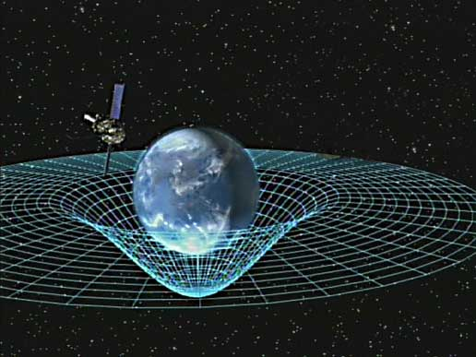
Nasa Photo

Slide 42
Newton defined gravity as attraction between masses.
As opposed to this, Einstein showed that gravity was not a force, but acceleration caused by dense matter warping the fabric of space so that objects fall toward the heavy material object pushing down on space-time.
Paste this web address on to your browser.
http://www.youtube.com/watch?v=AAqSCuHA0j8

Slide 43
One of the truly amazing facts of the universe is that the same event does not occur at the same time for an Earth traveler and a space traveler moving at excessive rates of speed.
An inertial frame of reference refers to those who share the same space and time by moving in a straight line at a constant speed.

Slide 44
So Earth time is the measure of our clocks as we spin on the earth’s axis and orbit about the sun.
But if we got into a rocket and travelled at speeds close to the speed of light, this would put us in a different inertial frame of reference.
Time would be slower and space would contract so that objects would be smaller.

Slide 45
When we returned to the earth, we would be younger than those whom we left behind.
This discrepancy is known as the breakdown of simultaneity, or time dilation.

Slide 46
The experience of space will also be different in a fast-moving rocket; someone on the earth would measure a stick as one square foot, but someone else observing the same stick traveling close to the speed of light will measure it as one square inch; and both would be right.
We are not talking merely about different perceptions of time and space, but the same event and the same stick are really different for two persons in different inertial frames of reference.

Slide 47
There is no absolute time and no absolute space; however, the speed of light is absolute.
No matter what inertial frame of reference that one might be located in, the speed of light is the same.
It is the speed limit of the universe.
If we got into a rocket and moved at great velocity through space at near the speed of light, we would move out of the present and into the future.

Slide 48
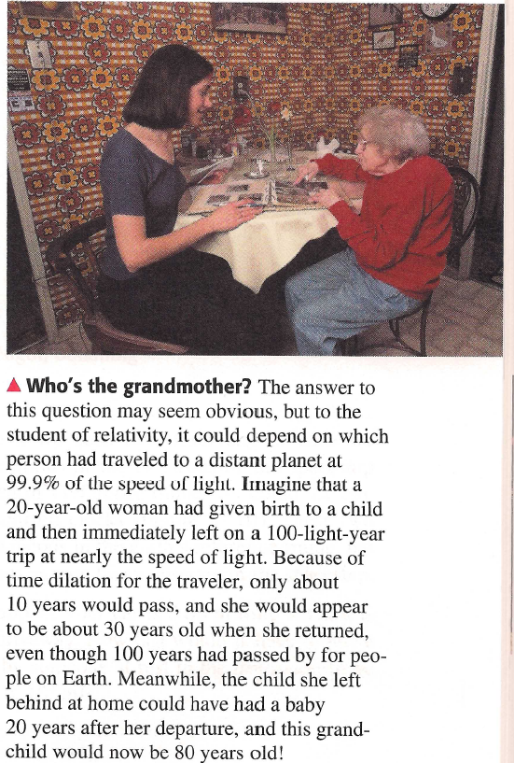
Sears & Zemansky’s College Physics, 8th ed, by Hugh D. Young and Robert M. Geller, Perason/Addison Wesley, 2007, p. 909.

Slide 49
We cannot, however, move into the past.
The only way that could be done is if we could go faster than the speed of light, which is the speed limit of the universe.
To do that, we are told it would take the amount energy that was released with the original explosion of the fireball that produced our universe in the beginning.

Slide 50
Serious and well respected theoretical physicists have theorized about people coming back from the future--all of which would be possible except for the river of time which always moves us forward into the future because we cannot muster up enough energy to shift things around to take us back into the past.
However, some physicists believe that quantum theory holds possibilities for showing how in fact it may be possible to engage in time travel.

Slide 51
Einstein introduced “the paradox of the twins” to illustrate travel into the future.
He argued that if one twin took a long trip on a spaceship going at nearly the speed of light, upon returning this twin would be much younger than the other twin who remained on the earth.

Slide 52
As a thought experiment, let us imagine that Peter tells his twin brother Paul to have a safe trip as he is launched into outer space at Kennedy Space Center traveling almost at the speed of light.

Slide 53
After being gone for 20 years, Paul would only be a few moments older than when he left, but Peter has had a lot of wear-and-tear in his life.
The 20 years of Peter’s life would have been compacted into a few moments and would have occurred for him almost simultaneously.

Slide 54
Similarly, God’s simultaneous knowledge of all time does not negate the real, unfolding developments that take place in our Earth time.
To be sure, Paul's observations were still happening in time, whereas God transcends all inertial frames of reference because God transcends the world as its Creator.

Slide 55
The breakdown of simultaneity between the two inertial frames of reference of Peter and Paul illustrates the coherence of the Boethian concept of omniscience.
This is because it is theoretically intelligible to say the same events could be spread out over time for one person and be virtually simultaneous for another person.
Paste this web address on to your browser
http://www.youtube.com/watch?v=yirQ4YXZZVk

Slide 56
Open Theism does not accept this illustration because it does not accept the space-time relativity of Einstein, although it has been repeatedly confirmed and universally embraced by science.
Open Theism places God and life on earth in the same category if time.
This concept of absolute time contradicts the insight of the Early Church Fathers, along with contemporary physics, that space and time came into existence together at the moment of creation.

Slide 57
Open Theism relies upon a discredited Newtonian interpretation that goes back behind Einstein to a transitional figure in science by the name of Lorentz.

Slide 58
An glaring misunderstanding of Einstein’s special relativity theory is contained in a widely-used textbook entitled Reason and Religious Belief, which supports Open Theism.
It embraces the discarded Lorentzian interpretation which has been experimentally shown to be false and then confuses it with “Albert Einstein’s Special Theory of Relativity.”

Slide 59
Its explanation of a Boethian interpretation is as mistaken as its understanding of Einstein’s theory of relativity.

Slide 60
Open Theism maintains God's mode of existence is that God exists as everlasting time.
As Father Clarke has noticed in his critique of process theology, this also creates enormous paradoxes for Open Theism based on Einstein's relativity theory of time because:
There is no single time-strand for the universe.

Slide 61
If space and time go together as a single entity, then the conclusion will be that of the Early Greek Fathers:
If God transcends space, God also transcends time.

Slide 62
The word aiōn (everlasting) was apparently first used by Plato to designate the idea of eternity as timelessness.
  ("time is the moving image of eternity, Timaeus 4 d)
Plato also used this word to entail a limited period of time.

Slide 63
This word in the New Testament was also used to denote a limited period of time.
Or it could denote a qualitative difference between time and the everlasting nature of God.

Slide 64
James Barr shows "there is a considerable likelihood that the early Christian understood the Genesis creation story to imply that the beginning of time was simultaneous with the beginning of the creation of the world, especially since the chronological scheme takes its departure from this date.”
In those instances where aiōn was used in reference to God, it does not include the idea of unending time.

Slide 65
Eternity entails duration, not lifeless abstraction.
Wesley argued that time and eternity belonged together and should not be divorced as though one was the opposite of the other.
Wesley asked : “And what is eternity? It is boundless duration.”

Slide 66
Wesley asked, “But what is time?”
Wesley answers: “Is it not in some sense a fragment of eternity, broken off at both ends?
The concept of duration is a term used in the history of theology to show that eternity entails the duration of life in its perfection. Eternal life is real enjoyment of self-conscious existence, not sheer timelessness.

Slide 67
Some have complained that I should allow for other interpretations of relativity theory than just Einstein's.
There are no other options.
There is no reason to reject the physical interpretation of time as experimentally established in contemporary science.

Slide 68
I also think it is unfortunate that Open Theism misinterprets contemporary physics by suggesting that space-time relativity may be replaced.
The official website for Open Theism says that quantum physics provides support for their view of time and that quantum physics is in conflict with relativity theory.
  This claim is based on a misinterpretation of a secondary source.

Slide 69
Space-time relativity remains the only view of contemporary physics, and
Quantum physics does not say that Einstein got this wrong.

Slide 70
There is a conflict between relativity theory and quantum physics, but each of these theories in right in their own field.
An object that is both very large and a very small at the same time as with black holes is how it came to be known that there is a conflict between relativity and quantum physics.
Einstein spent the declining years of his life trying to come up with a grand theory of everything that would reconcile these two realms.

Slide 71
The singularity within a black hole is similar to the original one that produced the big bang where space-time virtually disappears.
If anything, quantum theory could be used to illustrate the idea of timelessness, which Open Theism deplores.

Slide 72
The announcement is now being made on the Open Theism home webpage that Nobel-prize winning scientist Ilya Brigogine “is currently in the process of reconceiving all physical laws” that will bring a correction to Einstein’s theory of relativity.
The expectation is that these new laws will support the view of time that is assumed by Open Theism.

Slide 73
Apparently the proponents of Open Theism are not yet informed that Professor Brigogine died in 2003.
If the hope is that he is currently working on ways to replace Einstein's laws of nature, this must be disappointing news about his demise.
Further,Professor Brigogine embraced Einstein’s relativity theory and was not trying to replace it.

Slide 74
Almost in desperation, Open Theism wants to see Einstein's space-time relativity theory unraveled.
Its dismissive attitude is reminiscent of the Scopes Monkey Trial, where well-meaning Christians were trying to overthrow modern science and replace it with ad hoc explanations supposedly based on the Bible.

Slide 75
However, a proper understanding of Einstein’s relativity theory provides for a conceptuality to understand why God’s eternity transcends all inertial frames of reference.
It is fair enough to say that God does not know things in advance of them happening, as Boethius maintained,
But that is only half of the story because that is speaking from the standpoint of our earth time.

Slide 76
The rest of the story is that God as the Eternal One who embraces all times knows all things instantly.
If God is the Eternal Now, it is strictly meaningless to talk about what God knows today, since God's 'today' is eternity. It is true today that God knows what I shall do tomorrow, but is not true that God knows it today.

Slide 77
Considerable logical equivocation has been going on in contemporary philosophy and theology, from Nelson Pike to Open Theism:
Because it speaks of God as if God is finite and only exists in our time.

Slide 78
As the world’s Creator, God created space-time. If God transcends space, God transcends time.
As Kierkegaard once noted, it would be very embarrassing for God if after God created the world, God became dependent upon it and could not exist without it.
To be sure, there is still a tension between God's eternal knowledge of all things and human freedom, and in the final analysis this “is a mystery beyond our power to unravel."

Slide 79
Karl Barth has argued that the real issue of omniscience is whether or not God can be trusted.
The weakened capacity of God to know only with "probability" what lies before us in the theology of Open Theism may weaken one's capacity to trust in the Lord.

Slide 80
Isaiah declared that God can be trusted because God "knows the end from the beginning” and God knows "things not yet done" (Isa. 46:11).
If God can be mistaken, as Richard Swineburne frankly admits, why should one trust in divine wisdom?
One could at least forgive a friend who mistakenly advised us, but God? Would we be expected to forgive God if God misled us despite God's best intentions?

Slide 81
Barth is right. What is at stake is the meaning of trust--trust in the leadership of the Holy Spirit who will guides us into all truth.

Slide 82
"O Lord, you have examined my heart and know everything about me. You know when I sit down or stand up. You know my every thought when far away. You chart the path ahead of me and tell me where to stop and rest. Every moment you know where I am. You know what I am going to say even before I say it, Lord. You precede and follow me. You place your hand of blessing on my head. Such knowledge is too wonderful for me, too great for me to know!" (Psalm 139:1-6, NLT).

